Slide 1

Crude Oil Production & GDP Impact on Climate Change
Group Members:
Diana, Simon, Vino & Lee

Slide 2

Project Formulation
What we thought (hypothesis):
GDP and crude oil production correlate with changes in global temperature, causing sea ice mass deterioration.
Questions posed:
Can a direct correlation be identified between oil production and temperature increases?
Do increases in GDP impact climate change?
Is there a correlation between oil production and sea ice melt?

Slide 3
Data Gathering
Data was pulled from the NASA website and Index Mundi website for correlation analysis between oil production and temperature increases.
Temperature Data: https://data.giss.nasa.gov/gistemp/
Crude Oil Data: https://www.indexmundi.com/energy/?product=oil&graph=production
GDP data was pulled from The World Bank for correlation analysis between GDP and temperature increases.
GDP Data: https://databank.worldbank.org/indicator/NY.GDP.MKTP.KD.ZG/1ff4a498/Popular-Indicators#
To analyze potential correlation between sea ice melt, crude oil production & GDP increases, data was pulled from The EPA website.
EPA data:
https://www.epa.gov/climate-indicators/climate-change-indicators-glaciers https://www.epa.gov/climate-indicators/climate-change-indicators-arctic-sea-ice https://nsidc.org/data/glacier_inventory/query.html https://www.epa.gov/climate-indicators/climate-change-indicators-antarctic-sea-ice

Slide 4
Data Cleanup & Exploration
Pandas
Plotly
Bar Plots (hvplot)
Mapbox
Altair
Plot Ice Maps
Correlation Graph
Line Graphs (hvplot)
Correlation Plots
Numpy
Standard Deviation
Mean Values
Monte Carlo Simulations
Random Number Generator
Read CSV / Excel / HTML
Transpose Data Frames
Dropped Null Values
Calculate % Change
Name / Order Columns
Fill Blank Cells
Concatenate Data Frames

Slide 5
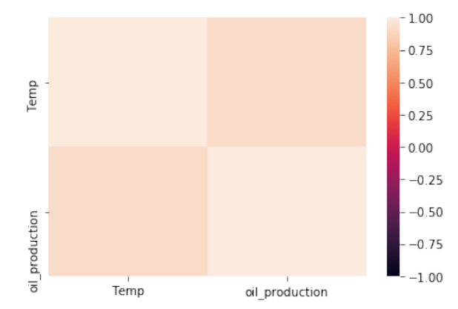
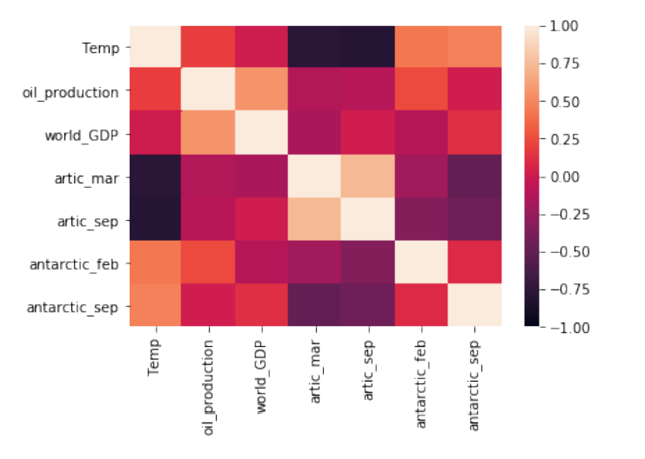
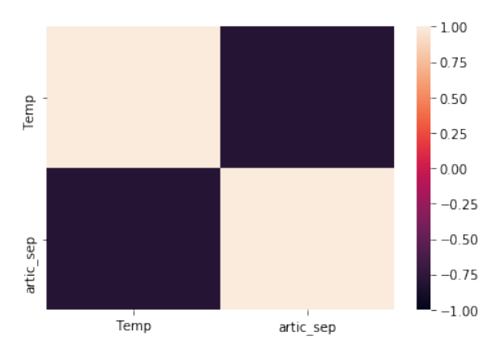
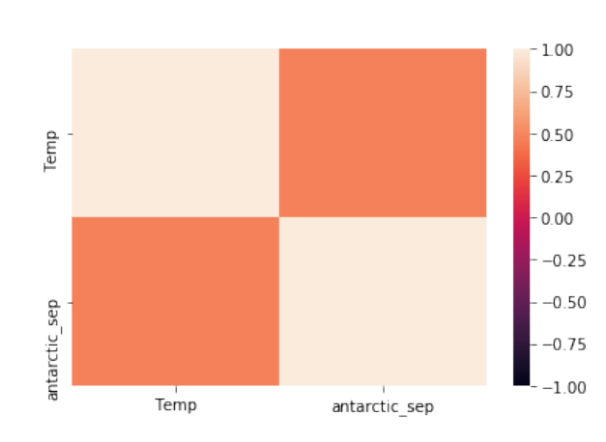
Data Analysis – Correlations

Slide 6
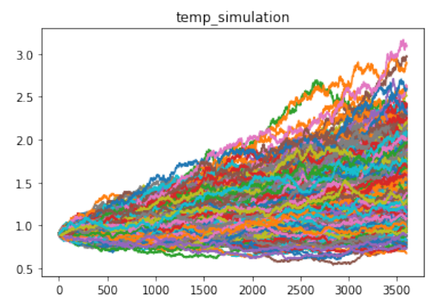
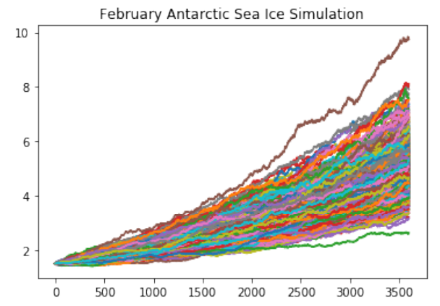
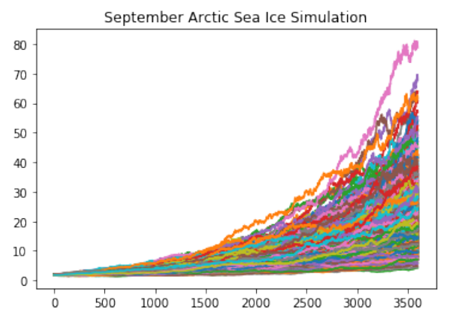
Data Analysis – Monte Carlo Simulations

Slide 7
Analysis for Discussion
Key Findings:
Correlation exists between world temperature and oil production.
No correlation between Arctic sea ice melt and crude oil production.
Slight correlation between Antarctic sea ice melt and crude oil production.
Estimated 2-degree Celsius temperature variance in the next 10 years, per Monte Carlo simulation.
Potential accelerated sea ice melt over the next 10 years, per Monte Carlo simulations.
Conclusions:
Global warming seems to be negatively impacting Arctic and Antarctic sea ice melt, based on our correlation analysis.
Increased oil production seems like it could be a factor driving increases in global temperatures, based on our correlation findings.

Slide 8
Data Cleanup & Exploration
Insights:
Sea ice data was more applicable than glacier data, which was originally used.
The date range used for this analysis had to be limited based on data availability.
GDP was grouped by region rather than country specific.
Problems:
Incomplete data sets.
Reading in certain file types.
Generating accurate Panel dashboards.
Jupyter Notebook Review / Analysis: (GDP_GreengasEmissions.ipynb)

Slide 9
Additional Thoughts & Questions
More to Consider:
Could a correlation between greenhouse gas emission and GDP be identified?
Is there a correlation between oil price and production?
How do crude oil ETFs impact crude oil production?
Determine what the lag period is for temperatures to change to allow for more detailed and in-depth analysis.
Identify exact temperature differences and detailed climate data in Arctic and Antarctic locations .
What is the impact of global warming on marine life?
How much does meat processing and consumption impact global warming?
What is the impact of inflation on global warming?

Slide 10

Questions?

